Slide 1
Introduction & Overview
Source of most materials:
Xiwei Xu, Ingo Weber, and Mark Staples. Architecture for Blockchain Applications. Springer, 2019

Slide 2
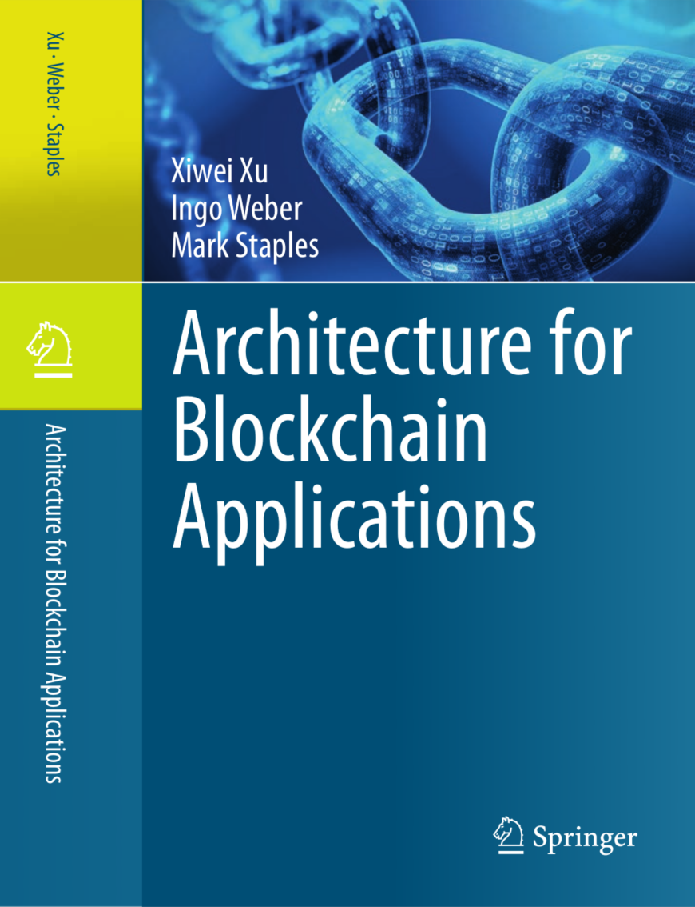
Book for this lecture: Architecture for Blockchain Applications
Xiwei Xu, Ingo Weber, Mark Staples.
Architecture for Blockchain Applications.
Springer, 2019.

Slide 3
What to expect from this course

Slide 4
Learning Outcomes
After successfully completing this course, you will be able to:
Explain the principles of blockchain and which roles it can play in an application architecture
Decide on the suitability of blockchains and how to design applications using them
Make functional and non-functional trade-offs for blockchain-based applications
Build small applications on blockchain

Slide 5

What is the Beef about Blockchain?
Video & reports:
https://www.data61.csiro.au/en/Our-Research/Focus-Areas/Distributed-Ledger-Technology-Blockchain
Notes:
https://www.data61.csiro.au/en/Our-Work/Safety-and-security/Secure-Systems-and-Platforms/Blockchain

Slide 6

Blockchain – replacing centralized trusted authority
Organization 1
Organization 2
Organization 1
Organization 2
Centralized Trusted Authority
Blockchain network
Traditional trusted environment
Blockchain trustless environment
Notes:
Another explanation of blockchain: Blockchain as p2p cloud computers enforcing a set of rules.
I explain blockchains as peer2peer cloud computers that collectively enforce a set of rules on a historical record that they create together. If the rules meet your needs, you can use the blockchain’s history as the source of truth for any information you want because no one can break those rules. Bitcoin’s rules define a currency: how are new tokens produced, how many are allowed, how they can be transferred from one person to another, etc. Ethereum’s rules define a process for defining new rules. This makes it a universal blockchain where rules for any interaction can be defined, and anyone can choose whether to treat its historical record as their source of truth.

Slide 7



How?
Blockchain network
Immutable data base
Public ledger
Every node hosts a replica
Distributed consensus
No central owner of consensus
Transaction is verified by every node
Combination of knowledge from Distributed Systems, Peer-to-Peer, Cryptography, Incentive Systems and Game Theory

Slide 8
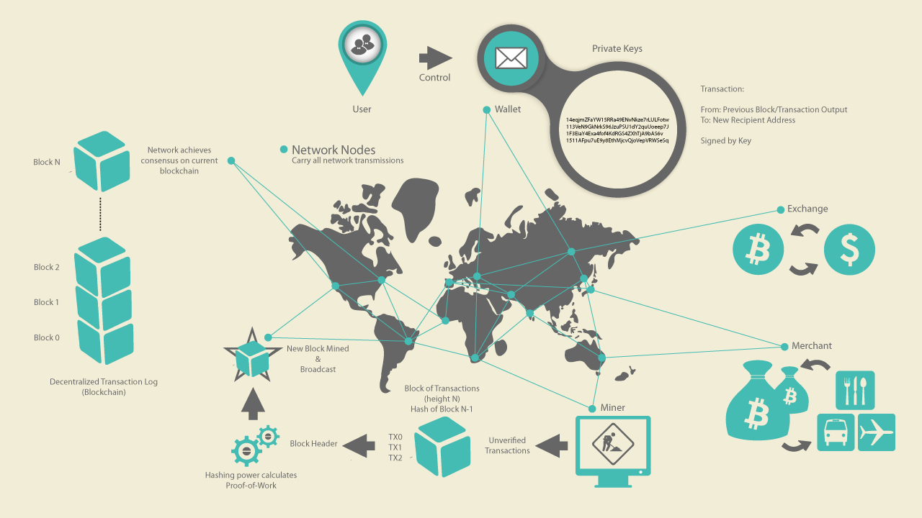
Blockchain 1st gen — Cryptocurrency
Users:
create transactions,
sign them, and
announce them to network
Miners:
receive transactions
include them in a new block,
(try to) append the new block to the data structure
When a transaction is part of the data structure, it has taken place (though it‘s a bit more complicated – more later).
Send 2 BTC from my account to Bob.
Signed: Alice
Picture source: A. Antonopoulos, Mastering Bitcoin, O'Reilly, 2014

Slide 9
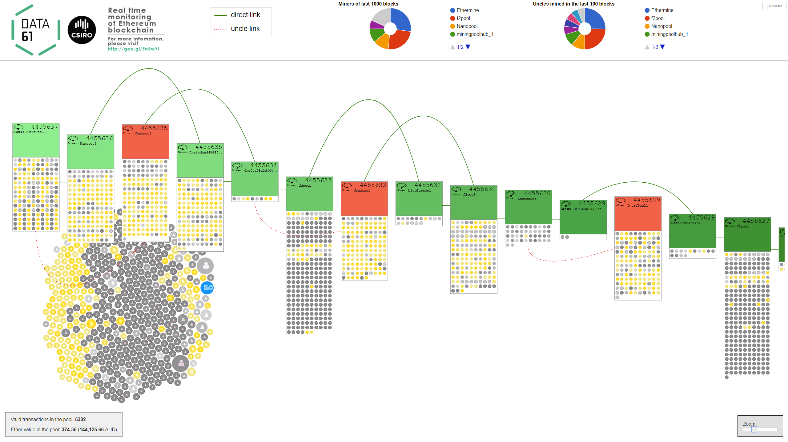
What is a Blockchain?
Visualization of a Blockchain: http://ethviewer.live
Notes:
http://www.ethviewer.live/
The chain of blocks:
We can see the data structure of blockchain. Each box represents a block. So blockchain is a list of blocks. Each block is linked to the previous block in the chain.
The most recent block is on the top left. Circles in the blocks show transactions included in those blocks. Blocks in the main chain are shown in green. Blocks become uncles are shown in red.
In each block we display the block number in the first line and the miner who created the block in the second line.
The “fuel gauge” in the left upper corner shows how much gas was used by the transactions in the block. It is relative to the block gas limit: E means empty, i.e., all available gas was used; F means full, i.e., no gas was used, which would be the case for an empty block.
The transaction pool shows transactions currently waiting to be included into a block. When a new block is created, typically a number of transactions from the pool are added to it.
Grey circles represent simple transfers, yellow circles are contract invocations, and blue ones represent contract creations. Depending on the connection, up to 50 or 500 transactions are shown. These are the most recent transactions that our node received.
The "Ether value in the pool" , if shown, is the sum of ether values of all transactions in the pool (not just the ones shown). The corresponding USD value is calculated based on the current average exchange rate from coinmarketcap.com .
The "Extended" view (button in the top right corner) groups the transactions in the pool based on the offered "gas price" (related to the transaction fee).
Clicking on blocks or transactions takes you to etherscan, a third party tool, and shows you details of this transaction or block.

Slide 10

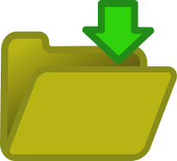


Blockchain 2nd gen – Smart Contracts
1st gen blockchains: transactions are financial transfers
Now Blockchain ledger can do that, and store/transact any kind of data
Blockchain can deploy and execute programs: Smart Contracts
User-defined code, deployed on and executed by whole network
Can enact decisions on complex business conditions
Can hold and transfer assets, managed by the contract itself
Ethereum: pay per assembler-level instruction

Slide 11
So what?
Well, blockchains are exciting because they can be used as a new foundation for re-imagining systems:
Neutral infrastructure for processing transactions and executing programs
Potentially interesting for innovation at all touch-points between organizations or individuals
Blockchain applications have the potential to disrupt the fabric of society, industry, and government
Blockchains can also be used as a technology platform to handle hard issues of data replication and system state synchronization with high integrity.

Slide 12
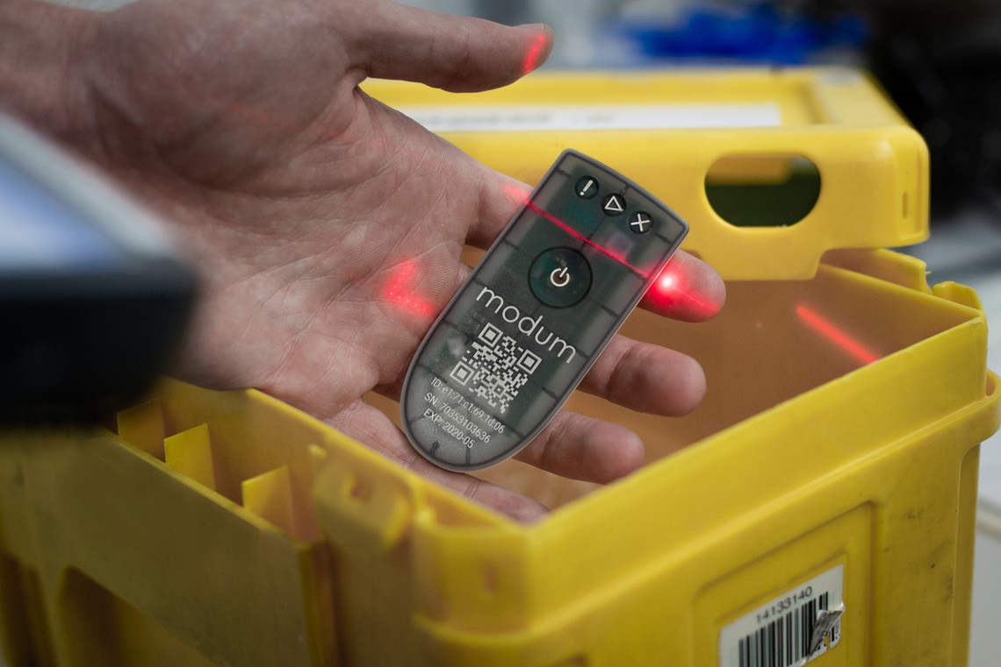
Selected Blockchain Projects
Australian Securities Exchange:
Settlement of trades to be sped up from 2-3 days to minutes, freeing up billions of $$
Under development, industry engagement & testing ongoing
Go-live of the blockchain system planned for March or April 2021
Modum.io:
Ensure drugs do not exceed a temperature threshold
Tamper-proof IoT device & blockchain storage of data
Otherwise: use refrigeration trucks, 4-8x pricier
Lygon.io
Joint initiative by Australian Banks
Platform for blockchain-based bank guarantees for commercial property leases
Digital bearer instrument
Picture source: modum.io

Slide 13
Relevant Topics in the Course
Architecting applications on Blockchain:
Taxonomy and design process
Blockchain as an element in an architecture
Functional and non-functional properties of blockchain
Blockchain patterns
Cost: how much (more) will using blockchain cost?
Latency: simulation under changes
Security and dependability
Model-driven development of smart contracts
Business process execution
Model-based generation of registries and UIs

Slide 14
Functions blockchain can provide in an application architecture
Architectural Element
Storage Element
Computational Element
Communi-cation Mechanism
Asset Management and Control Mechanism
Blockchain as…

Slide 15
Course Content (1)
Lecture Topic | Relevant Book Chapters
Introduction | Introduction
Existing Blockchain Platforms | 4. Example use cases 2. Existing Blockchain Platforms (1h on smart contract dev)
Software architecture basics
Blockchain in Software Architecture | 3. Varieties of blockchain 5. Blockchain in Software Architecture (Non-functional properties and trade-offs) 6. Design Process for Applications on Blockchain (DevOps of blockchain)
NFPs | 9. Cost 10. Performance 11. Dependability and Security

Slide 16
Course Content (2)
Lecture Topic | Relevant Book Chapters
Design Patterns for Blockchain Applications | 7. Blockchain Patterns (design pattern basics, design pattern language)
Model-Driven Engineering | 8. Model-driven Engineering for Applications on Blockchains (model-driven basics, UML)
Case studies / guest lectures | Case study chapters
Summary | Summary (including Epilogue content) Discussion of disruptive potential, high-level opportunities and risks

Slide 17
Terminology

Slide 18
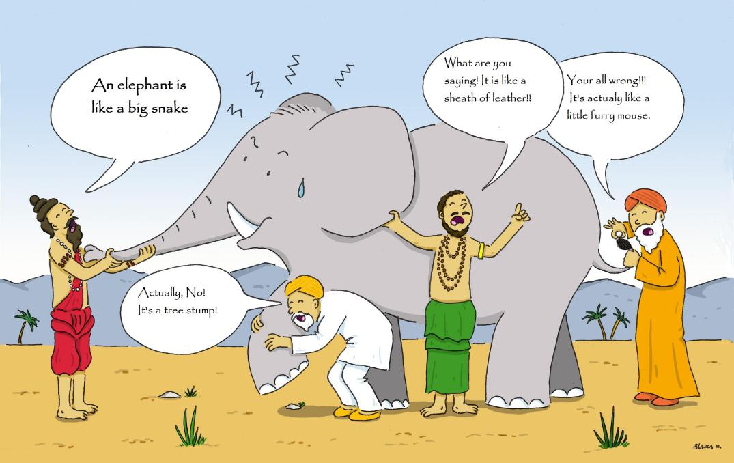
What is a blockchain?
Parable of the blind men and the elephant, see e.g., https://wildequus.org/2014/05/07/sufi-story-blind-men-elephant/ (source of figure)

Slide 19
What is a blockchain?
No, it’s a code execution platform!
Actually, it‘s a network!
Clearly, it’s a BPMS!
It‘s a database!
Parable of the blind men and the elephant, see e.g., https://wildequus.org/2014/05/07/sufi-story-blind-men-elephant/ (source of figure)

Slide 20
Defining Blockchain (1)
Distributed Ledger
An “append-only” transaction store distributed across machines (immutability)
A new transaction might reverse a previous transaction, but both remain part of the ledger
Blockchain
A distributed ledger structured into a linked list of blocks
Each block contains an ordered set of transactions
Use cryptographic hashes to secure the link from a block to its predecessor
Notes:
The first one is distributed ledgers. A distributed ledger is an append-only transaction store which is distributed across many machines. Append only mean new transactions can be added to the ledger, but old transaction cannot be deleted or modified. A new transaction might reverse a previous transaction, but both of them should remain part of the ledger to allow auditability and ensure long-lasting integrity.
Blockchain is a distributed ledger that is structured into a linked list of blocks. Each block contains an ordered set of transactions. Typical solutions use cryptographic hashes to secure the link from a block to its predecessor.
This means block n+1 includes hash of block n. and block n+2 includes hash of block n+1. This ensures that a previous block cannot be changed. If the previous block was changed, its new hash would not match the originally recorded hash, so the link between the two blocks would break.

Slide 21
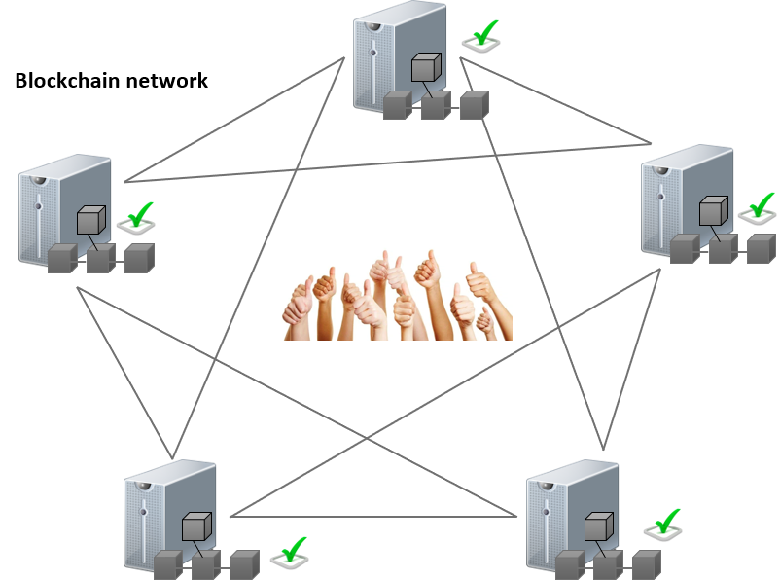
Defining Blockchain (2)
A Blockchain System consists of
A blockchain network of nodes
A blockchain data structure
For the ledger replicated across the blockchain network
Full nodes hold a full replica of the ledger
A network protocol
Defines rights, responsibilities, and means of communication, verification, validation, and consensus across the nodes in the blockchain network
Includes ensuring authorisation and authentication of new transactions, mechanisms for appending new blocks, incentive mechanisms

Slide 22
Defining Blockchain (3)
A Public Blockchain is a blockchain system with the following characteristics:
Has an open network
Nodes can join and leave without requiring permission from anyone
All full nodes can verify new transactions and blocks
Incentive mechanism to ensure the correct operation
Valid transactions are processed and included in the ledger and invalid transactions are rejected
A Blockchain Platform is the technology needed to operate a blockchain
Blockchain client software for processing nodes
The local data store
Alternative clients to access the blockchain network
Notes:
1m

Slide 23
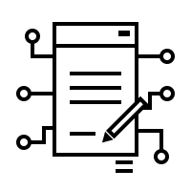
Decentralised Applications and Smart Contracts
Smart contracts
Programs deployed as data and executed in transactions on the blockchain
Blockchain can be a computational platform (more than a simple distributed database)
Code is deterministic and immutable once deployed
Can invoke other smart contracts
Can hold and transfer digital assets
Decentralized applications or dapps
Main functionality is implemented through smart contracts
Backend is executed in a decentralized environment
Frontend can be hosted as a web site on a centralized server
Interact with its backend through an API
Could use decentralized data storage such as IPFS
“State of the dapps” is a directory recorded on blockchain: https://www.stateofthedapps.com/
https://thenounproject.com/term/smart-contract/1709925/
Notes:
Decentralized applications or Dapps are applications that are designed to provide their main functionality through smart contracts
Smart contracts are programs deployed as data in the blockchain ledger, and executed in transactions on the blockchain.
Smart contracts can hold and transfer digital assets managed by the blockchain, and can invoke other smart contracts stored on the blockchain. Smart contract code is deterministic and immutable once deployed.
The Bitcoin blockchain allows only very simple forms of smart contracts, but other blockchains such as Ethereum allow computer programs to be written in a “Turing complete” language. In principle, it can be as expressive as every other general purpose programming language. As a result, blockchains can be more than a simple distributed database — they can be general computational platforms.
40s
InterPlanetary File System (IPFS)

Slide 24
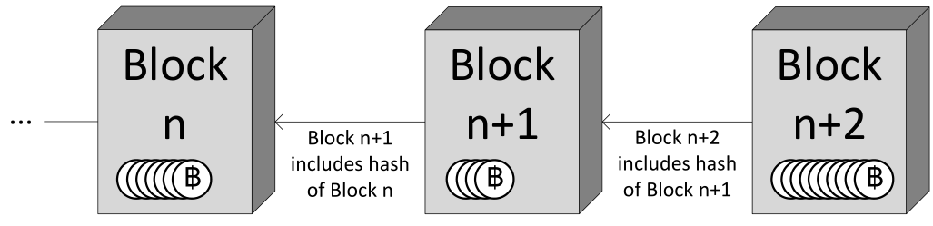
Blockchain defined (1/4) Verbatim from the Book
Definition 1 (Distributed Ledger). A Distributed Ledger is an append-only store of transactions which is distributed across many machines.
Definition 2 (Blockchain (Concept)). A Blockchain is a distributed ledger that is structured into a linked list of blocks. Each block contains an ordered set of transactions. Typical solutions use cryptographic hashes to secure the link from a block to its predecessor.

Slide 25
Blockchain defined (2/4) Verbatim from the Book
Definition 3 (Blockchain System). A Blockchain System consists of:
a blockchain network of machines, also called nodes;
a blockchain data structure, for the ledger that is replicated across the blockchain network. Nodes that hold a full replica of this ledger are referred to as full nodes;
a network protocol that defines rights, responsibilities, and means of communication, verification, validation, and consensus across the nodes in the network. This includes ensuring authorization and authentication of new transactions, mechanisms for appending new blocks, incentive mechanisms (if needed), and similar aspects.

Slide 26
Blockchain defined (3/4) Verbatim from the Book
Definition 4 (Public Blockchain). A Public Blockchain is a blockchain system that has the following characteristics:
it has an open network where nodes can join and leave as they please without requiring permission from anyone;
all full nodes in the network can verify each new piece of data added to the data structure, including blocks, transactions, and effects of transactions; and
its protocol includes an incentive mechanism that aims to ensure the correct operation of the blockchain system including that valid transactions are processed and included in the ledger, and that invalid transactions are rejected.

Slide 27
Blockchain defined (4/4) Verbatim from the Book
Definition 5 (Blockchain Platform). A blockchain platform is the technology needed to operate a blockchain. This comprises the blockchain client software for processing nodes, the local data store for nodes, and any alternative clients to access the blockchain network.
Definition 6 (Smart Contract). Smart contracts are programs deployed as data in the blockchain ledger, and executed in transactions on the blockchain. Smart contracts can hold and transfer digital assets managed by the blockchain, and can invoke other smart contracts stored on the blockchain. Smart contract code is deterministic and immutable once deployed.
Definition 7 (dapp). A decentralized application or dapp is a software system that is designed to provide its main functionality through smart contracts.

Slide 28
Cryptocurrencies and Tokens
Cryptocurrencies
‘Baked in’ to the core platform of public blockchains -base currency of blockchains
Symbiotic relationship
Blockchain keeps track of the ownership of portions of that currency, e.g. Alice owned 2Ether, transferred 1 Ether to Bob, offered 0.01Ether to miner
Cryptocurrency enables the incentive mechanism for blockchain operations
Digital tokens
Created and exchanged using smart contracts
Represent assets
Fungible asset: individual units are interchangeable, e.g. company share, gold
Non-fungible asset: represents a unique asset, e.g. cryptokitties, car title
Not all applications are the same:
Transferring coins / tokens vs. tracking movement of physical goods
Core difference: where is the default version of the truth, on or off-chain?
Notes:
1m 30s
Cryptocurrencies are the base currency of blockchains. Ether is the currency of the public Ethereum blockchain, and Bitcoin is the currency of the public Bitcoin blockchain.
The respective blockchain keeps track of the ownership of portions of that currency.
Say, Alice owns 2 Ether and announces a transaction to transfer 1 Ether to Bob, offering a fee of 0.01 Ether. Once the transaction is included in a block mined by Charly, Alice has 0.99 Ether, Bob 1, and Charly received the fee of 0.01 Ether. The sum of the money is not changed by the transactions, but the ownership of portions of it are.
Fees for transaction inclusion are paid in the base currency of a blockchain, although the client can choose to offer a fee of 0 (typically reducing the speed and/or likelihood of inclusion). Fees often relate to the size of a transaction, not its value: more data (including larger smart contracts to be deployed) incur higher fees. Similarly, more complex computations as a result of smart contract invocations incur higher fees. Transfers of 0.01 Ether incur the same fees as transfers of 100 Ether.
Digital tokens can be created and exchanged on blockchains. Usually tokens are created using smart contracts. Similar to a cryptocurrency, each token is controlled by an actor on the blockchain. Tokens might represent shares in a company, the right to benefit from future earnings, or perhaps virtual gold in an online game. The use of tokens has become wide-spread, and tokens can be seen as the first “killer app” of using blockchain for things other than cryptocurrency.

Slide 29

Fungible and Non-fungible Tokens
Fungible tokens: interchangeable
E.g., $2 coin, $10 note
Main concern: how many?
Ethereum: ERC20 standard
https://ethereum.org/en/developers/docs/standards/tokens/erc-20/
Example: OMG Network
“The OMG Network comprises a decentralized exchange, liquidity provider mechanism, clearinghouse messaging network, and asset-backed blockchain gateway. … It uses the mechanism of a protocol token to create a proof-of-stake blockchain to enable enforcement of market activity amongst participants. Owning OMG tokens buys the right to validate this blockchain, within its consensus rules.”
Non-fungible tokens
E.g., houses, cars, patents
Main concern: which ones?
Ethereum: ERC721
https://github.com/ethereum/EIPs/issues/721
Example: cryptokitties https://www.cryptokitties.co/
Kitties are non-fungible, individual, and their appearance depends on the individual features
Notes:
OMG Network, previously OmiseGo

Slide 30



Student Task
Take 3 minutes to think about examples of fungible and non-fungible assets that you know of
Take notes
Then we’ll discuss these

Slide 31
Blockchain Applications & Application Areas

Slide 32
Blockchain-based Application
A blockchain-based application (or just blockchain application) makes significant use of blockchain
Dapps are an example, but the concept is far broader
Significant portions of such applications can be based on traditional systems.
Globally, many financial services companies, enterprises, startups, and governments are exploring suitable applications
Areas include supply chain, electronic health records, voting, energy supply, ownership management, and protecting critical civil infrastructure
By now, most if not all industry sectors have explored blockchain use
→ This course (and the book) are about what you need to know to design and build blockchain-based applications

Slide 33
Application Areas – Enterprises and Industry
Supply chain
IoT
Utility resources and services
Digital rights and IP management
Store key events to ensure goods provenance and logistic visibility
Device access control and software/configuration updates
Monitoring and payment of usage
A trusted media asset registry to store hashes, meta-data or other identifier on blockchain and manage access and right information
Data management
A metadata layer for decentralized data sharing and analytics - to discover and integrate large datasets and data analytics services
Proof of existence
Store a timestamped record of a hash of the document
Inter-divisional accounting
A shared distributed ledger of inter-divisional accounts
Corporate affairs
Board and shareholder voting and registration
Notes:
3m
Blockchains were first used for cryptocurrency, but are now being used for many other purposes. Here we list all the application areas for blockchain.
For supply chain, when we store key events on blockchain to ensure goods provenance, and improve logistic visibility and supply chain quality. Key events could also be linked to automatic payments using of smart contracts. That is called delivery vs. payment.
For IoT, blockchain can be used for device access control. It can also store information about IoT software and configuration updates and dynamically-delegated access.
Monitoring and payment for usage of utilities or services can be provided by using smart contracts and IoT devices.
Blockchain can provide a trusted registry for media asset or other IP. It can manage access and right information for media asset. Media assets are not necessarily stored on the blockchain. We can store their cryptographic hashes, meta-data and other identifiers stored on the blockchain and store the raw data off-chain.
A blockchain can create a metadata layer for decentralised data sharing and analytics. Although we cannot store large datasets themselves on blockchain, it can help to discover and integrate those datasets and data analytics services. Access control mechanisms implemented on a blockchain may allow public data sources to be integrated more easily with private data sets and analysis services.
Blockchain can be used to record evidence of the existence of data or documents, by creating a timestamped record of a cryptographic hash of the contents of those documents. This can be combined with records of the attestation or witnessing of corresponding physical documents by trusted third-parties.
Multi-national companies or large enterprises with separate divisional business units often have governance needs to control their own internal accounting, but also share accounting information with other divisions. A straightforward application of blockchain technologies on a shared private network can create a shared distributed ledger of inter-divisional
accounts at the interfaces between divisions.
Corporate affairs, like board and shareholder voting and registrations, the voting authorities of board members or shareholders in companies could be recorded and proxied on a blockchain. Smart contracts on blockchains could use that record to adjudicate votes conducted on the blockchain for specific motions. Cryptographic mechanisms may be required to prevent potentially undesirable strategic voting behaviours.

Slide 34
Application Areas – Financial Services
Digital currency
New form of money transferred without 3rd parties
Programmable money: attach policies to specific parcels of currency
(International) payments
Via digital currency with local exchanges between the digital currency and FIAT currencies
Pseudonymous: but usually have regulatory requirements to have identity, e.g. Anti-Money Laundering (AML)
Reconciliation for correspondent banking
Banks can create a single shared ledger of accounts maintained in real-time
Securities settlement
The exchanged assets are represented by tokens using smart contracts
Payment are made using tokens or native cryptocurrency
Markets
Provides a platform for making and accepting offers to trade assets or services
Record the status of the offers
Trade finance
Evidence trade-related documents
Automate payments
Notes:
2m30s
Digital currency is a new form of money. It can be implemented on blockchains. Digital currency can also serve as a foundation for incentive models that support data integrity for
many blockchain systems. Blockchains allow digital currency to be transferred between parties, often without those transfers being processed or recorded by banks or
payment services. With smart contracts, blockchains may be able to support “programmable money”. Some policies can be attached to specific parcels of currency.
(International) payments: can be done by blockchain, often via digital currency with local exchanges between the digital currency and fiat currencies. Public blockchain cryptocurrency payments are usually pseudonymous. For example on Bitcoin, transacting agents (which are not necessarily persons) are only identified with a cryptographic key. Therefore international exchange of the Bitcoin digital currency can be performed without establishing real-world identity, and we may not know which actual person is behind which account. But international payments usually have regulatory requirements to have the identity of participants, e.g. Anti-Money Laundering (AML) policies. It is often required that the transacting parties establish their real-world identities to each other.
Reconciliation for correspondent banking: Rather than conducting laborious end-of-day reconciliation as a batch task, the two banks can create a single shared view of truth between their accounts, maintained in real time.
Securities settlement: The exchanged assets are typically represented by tokens implemented on the blockchain using smart contracts. Payments are sometimes made using such tokens or using the native cryptocurrency on the blockchain.
Markets: smart contracts on blockchains can provide a platform for making and accepting offers to trade assets or services. The blockchain will record the status of these trade offers. Individual smart contracts could carry the digital currency required to be paid on fulfilment of these offers. This functions as a kind of escrow, without the need for a trusted third-party organisation.
Trade finance: the blockchain can be used to evidence trade-related documents in order to reduce lending risk and improve access to finance for industry. Smart contracts
could control inter-organisational process execution and transparently automate instalment payments.

Slide 35
Application Areas – Government Services
Registries and identity
Including identities of persons, companies or devices; licensing; qualification; and certification
Grants and social security
Automate the process coordination for application, decision making, and payment distribution
Allow conditional payments through programmable money – e.g. NDIS – where the money checks the conditions for spending it when attempting to do so
Resource quota management
Government granted quotas, allocations, rights to physical resources could be awarded and tracked through tokens
E.g. water access licenses can provide rights to take a certain volume of water from specific sources during specific time frames
Taxation
Automate tax collection using smart contract
Notes:
1m30s
Registries and identity, including the identities and attributes of persons, companies, or devices; licensing; qualifications; and certifications. Storing registry entries or cryptographic certification of registry entries on a blockchain can facilitate access to and validation against the register. Blockchains could be used to share authenticated identifiers for individuals and companies, and these identifiers could in turn also enable many other blockchain applications. Blockchains can support federated management of multiple related registries, by allowing different agencies to retain authoritative control over the contents of their registers, but still provide a shared view of truth about how their registers are inter-related.
Grants and social security: smart contracts could automate the process coordination to apply for, decide on, and distribute payments for grants and social security.
A smart contract could automatically limit payments to approved suppliers or categories of expenses. One early use of blockchain in this way was to account for allowances and payments by
refugees in a UN refugee camp.
Quota management: Government-granted quotas, allocations, and rights to physical resources could be awarded and tracked through tokens established on a blockchain.
Examples include water access licences providing rights to take a certain volume of water from specific sources during specific time frames
Taxation: automated collection of tax using smart contracts

Slide 36
Summary
Introduction
Terminologies and definitions
Blockchain-based applications and application areas

Slide 37
Introduction & Overview
Source of most materials:
Xiwei Xu, Ingo Weber, and Mark Staples. Architecture for Blockchain Applications. Springer, 2019

